Slide 1
Methanococcus Meeting
7/31/2014
University of Washington

Slide 2
Overview
Updates
Comparison to Genome Paper
Orphan Genes
Essential Genes
Distinguishing AND/OR
Going Forward

Slide 3
Updates
Added 2 specific ferredoxins to group reactions
EhA, HdrABC
EhB, Indolepyruvate oxidoreductase, CO-dehydrogenase, 2-oxoglutarate synthase, rxn05939
Added gene associations
Corrected gene names

Slide 4
Model Validation

Slide 5
Tracking Model Evolution
Draft
724 metabolites
708 reactions
May 8
412 genes
735 metabolites
June 6
414 genes
736 metabolites
388 genes
730 reactions
722 reactions
June 26
459 genes
743 metabolites
736 reactions

Slide 6
Comparison to Genome Paper
459 genes in model
185 in the paper
274 not in the paper
75 genes in the paper, not the model
Possible disagreements (e.g. mmp0127 v. mmp0372)

Slide 7
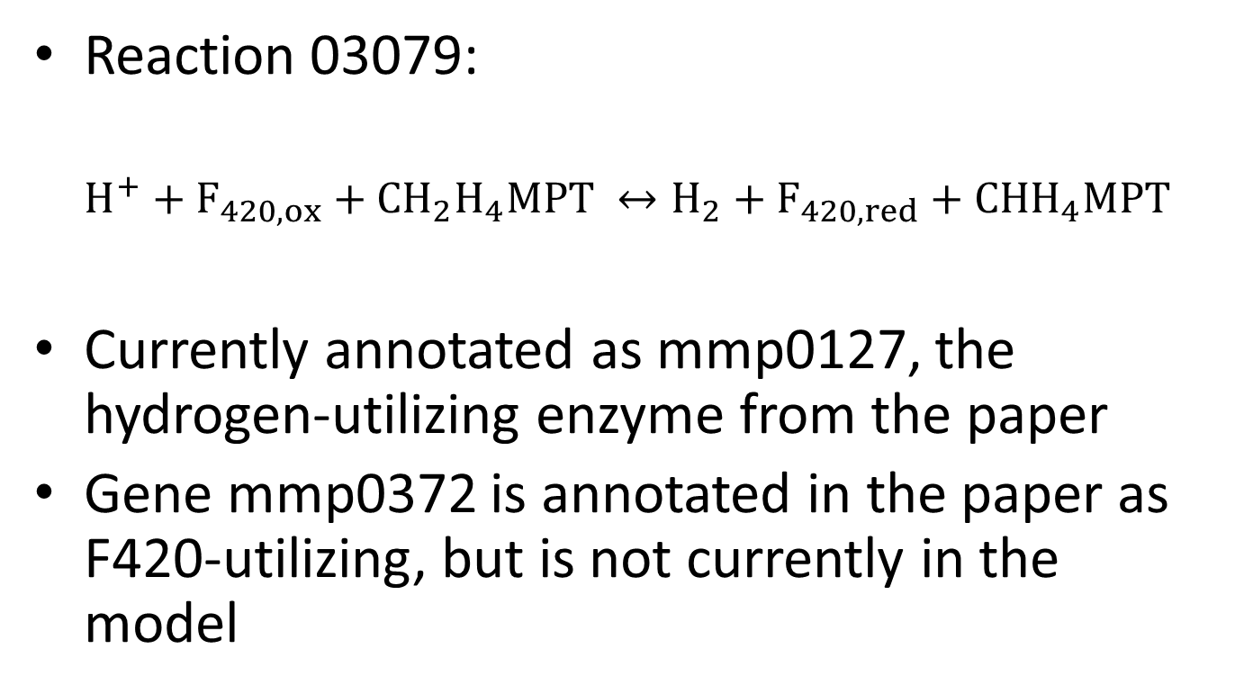
Possible Disagreement
Reaction 03079:
$$H^{+}+F_{420,ox}+CH_{2}H_{4}MPT ↔H_{2}+F_{420,red}+CHH_{4}MPT$$
Currently annotated as mmp0127, the hydrogen-utilizing enzyme from the paper
Gene mmp0372 is annotated in the paper as F420-utilizing, but is not currently in the model

Slide 8
Orphan Genes
5 genes in the model have no reaction:
mmp1233
mmp1697
mmp0264
mmp0372
mmp0534
What do they do?

Slide 9
Essential Genes
We’re looking for knockout targets
Only 27 genes predicted essential
Only 69 genes cause reaction knockouts
402 reaction KOs are predicted to be lethal

Slide 10
AND/OR Relationships
Clearly causing essentiality differences
How do we best get to the bottom of these?
Iterate through all 700+ reactions?
Pick out specific sets?
Other?

Slide 11
Going FOrward
Verifying and inserting absent genes
Clarifying some GPR relationships
Resolving AND/OR relationships
Generating gene essentiality data

